Slide 1

Sustainability and Environmental Impact
As we move towards a more sustainable future, it's essential to consider the environmental impact of our practices. Implementing eco-friendly practices and undergoing environmental impact assessments are crucial steps towards a better tomorrow.

Slide 2
Considerations for Sustainability
1
Reduce Waste
2
Focus on Energy Efficiency
From reducing single-use plastics to composting, small changes can make a massive impact.
Switching to renewable energy sources like wind, solar, or hydro can reduce emissions and save money.
3
Support Local Communities
4
Invest in Sustainable Technologies
Choose sustainably and locally sourced products and support small businesses to reduce transportation energy use.
From recycled materials to biodegradable products, innovative technologies can reduce waste and pollution.

Slide 3
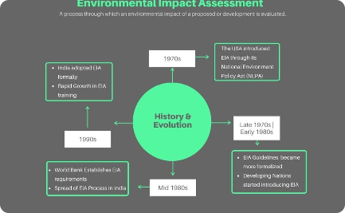


Environmental Impact Assessment
Assessing the Impact
Gathering and Analyzing Data
Considering Public Concerns
An environmental impact assessment considers the potential effects of a project or development on the environment.
By looking at data from soil, air, and water tests, the environmental impact assessment can determine the potential impact.
The assessment must also take into account the concerns of local communities and other stakeholders.

Slide 4

Eco-friendly Practices Implemented
1
Solar Panels
Installing solar panels can provide clean energy while reducing electricity bills.
2
Water Conservation
Reducing non-essential water use and installing low-flow fixtures can conserve water and save money.
3
Composting
Composting can reduce organic waste and produce nutrient-rich soil.

Slide 5

The Benefits of Sustainable Practices
Environmental Benefits
Social Benefits
Economic Benefits
Support local communities, promote social equity and justice, and improve public health by using sustainable practices.
Increase cost savings, create jobs, and improve economic stability by adopting sustainable practices.
Reduce pollution, conserve natural resources and ecosystems, and protect biodiversity with sustainable practices.

Slide 6



The Future of Sustainability
Innovative Technologies
Sustainable Cities
Sustainable Fashion
New technologies like advanced recycling systems and lab-grown meat are poised to revolutionize sustainability.
Cities around the world are committing to sustainable development, from green roofs to sustainable public transportation.
Eco-friendly and fair labor practices are gaining popularity in the fashion industry, from organic cotton to upcycling old clothes.

Slide 7

Corporate Responsibility for Sustainability
1
Environmental Policy
Creating a comprehensive environmental policy can help guide a company's sustainable practices.
Reducing Carbon Footprint
2
Reducing a company's carbon footprint by implementing energy-saving measures and switching to renewable energy sources can greatly impact sustainability.
3
Corporate Social Responsibility
Corporate social responsibility can include actions such as community engagement, philanthropy, and ethical business practices.

Slide 8
Sustainability for Individuals
In the Kitchen
At Home
On the Go
Choose reusable water bottles and coffee cups.
Save energy and water with low-flow fixtures and energy-efficient appliances.
Bike, walk, or take public transportation when possible.
Reduce food waste by planning meals and composting.
Switch to renewable energy sources.
Choose electric or hybrid cars.
Choose sustainable and locally sourced foods.
Use eco-friendly cleaning products.
Reduce single-use plastics by bringing reusable bags and containers.

